Slide 1
CSE291 – Introduction to Software Engineering (Fall 2022)
Class Diagrams

Slide 2
Class diagrams
Class diagrams are used when developing an object-oriented system model
To show the classes in a system and the associations between these classes.
An class can be thought of as a general definition of one kind of system object.
An association is a link between classes that indicates that there is some relationship between these classes.
When you are developing models during the early stages of the software engineering process, objects represent something in the real world, such as a patient, a prescription, doctor, etc.

Slide 3
Class diagrams
Class diagrams in the UML can be expressed at different levels of detail.
The simplest way of writing these is to write the class name in a box.
Show the existence of an association by drawing a line between classes.
Patient
1
1
Patient Record

Slide 4
UML Classes and association
A simple class diagram showing two classes: Patient and Patient Record with an association between them
In this example, each end of the association is annotated with a 1, meaning that there is a 1:1 relationship between objects of these classes.
That is, each patient has exactly one record and each record maintains information about exactly one patient.
Patient
1
1
Patient Record

Slide 5
Classes
The class diagram also describes/show the attributes and operations of a class.
A class is a description of a set of objects that share the same attributes, Operations and relationships.
In UML-
An object class is represented as rectangle, usually including its name, attributes, and operations in separate, designated compartments.
Class Name
attributes
operations

Slide 6
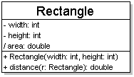
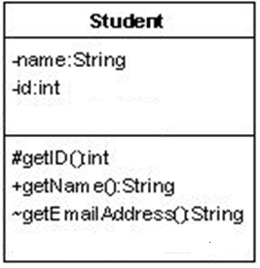
Diagram of One Class
Class name in top of box (Mandatory)
Attributes (optional)
Operations / methods (optional)

Slide 7
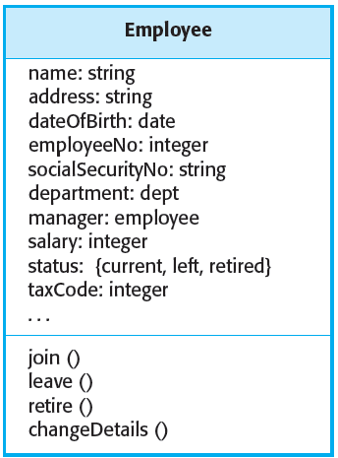

Examples

Slide 8
Class Attributes
attributes
name : type
Visibility/Access modifier
+ public # protected - private / derived

Slide 9
Class Operations / Methods
operations / methods
name (parameters) : return type
Visibility/Access modifiers
+ public # protected - private
parameter types listed as (name: type)

Slide 10
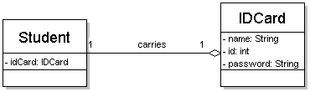
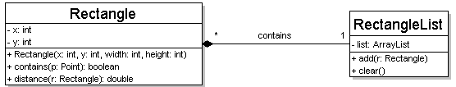
Multiplicity of Associations
one-to-one
each student must carry exactly one ID card
one-to-many
one rectangle list can contain many rectangles

Slide 11
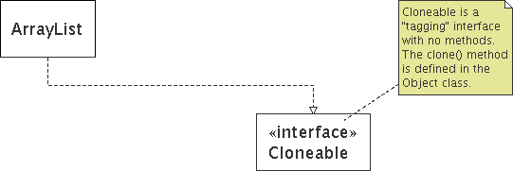
Comments
Represented as a folded note, attached to the appropriate class/method/etc by a dashed line

Slide 12
Relationships

Slide 13
Association
Objects that are members of an object class participate in relationships with other objects.
These relationships modeled by describing the associations between the object classes.
In the UML, associations are denoted by a line between the object classes that may optionally be annotated with information about the association.

Slide 14
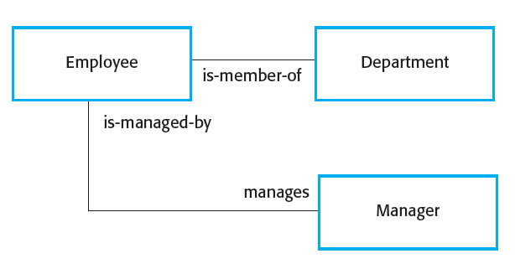
Association Model

Slide 15
Generalization
Generalization is an everyday technique that we use to manage complexity.
Rather than learn the detailed characteristics of every entity that we experience, we place these entities in more general classes (animals, cars, houses, etc.) and learn the characteristics of these classes.
This allows us to infer that different members of these classes have some common characteristics

Slide 16
Generalization
In object-oriented languages, such as Java, generalization is implemented using the class inheritance mechanisms built into the language.
In a generalization, the attributes and operations associated with higher-level classes are also associated with the lower-level classes.
The lower-level classes are subclasses inherit the attributes and operations from their super classes. These lower-level classes then add more specific attributes and operations.

Slide 17
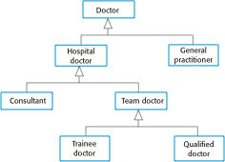
A Generalization Hierarchy

Slide 18
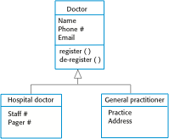
A Generalization Hierarchy with Added Details

Slide 19
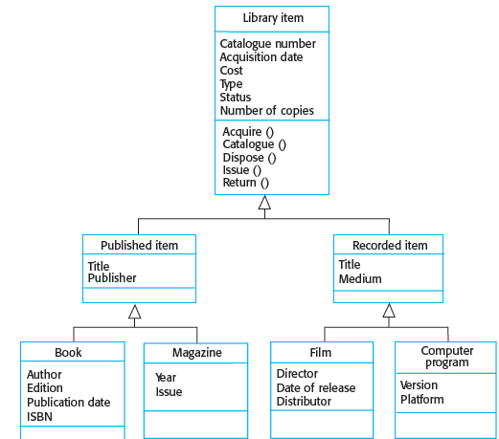
Library Class Hierarchy

Slide 20
Object Class Aggregation Models
Objects in the real world are often composed of different parts.
For example, a study pack for a course may be composed of a Assignments, PowerPoint slides, Lecture notes, and Video tapes. Sometimes in a system model, you need to illustrate this.
The UML provides a special type of association between classes called aggregation that means that one object (the whole) is composed of other objects (the parts).
To show this, we use a diamond shape next to the class that represents the whole.

Slide 21
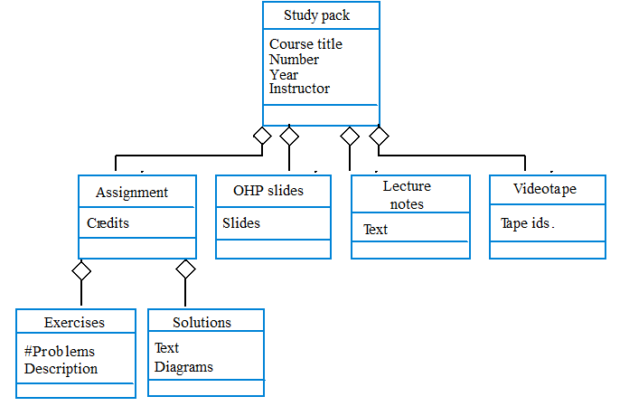
Object Aggregation

Slide 22
UML Class Diagram Exercise
In a university there are different rooms and departments.
Rooms are allocated as a classrooms or some as offices.
A department has a name and it contains many offices.
A person working at the university has a unique ID and can be a professor or an employee.
• A professor can be a full, associate or assistant professor and he/she is enrolled in one department.
• Offices and classrooms have a number ID, and a classroom has a number of seats.
• Every person works in an office

Slide 23
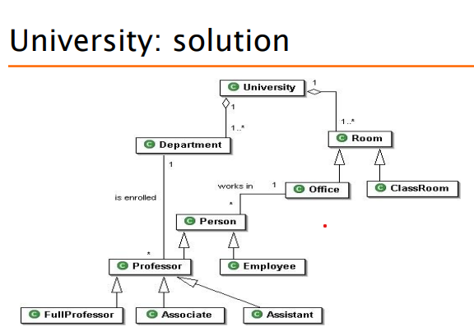

Slide 24
Chapter Reading
Chapter 7, Design and Implementation,
Software Engineering by Ian Sommerville
Course Material Link:
https://sites.google.com/a/cuilahore.edu.pk/se_fall18/

